Slide 1
Phase 4 – Team Foxtrot
The God Complex Missile Defence System
2nd Lt Claire Badger
2nd Lt Mark Demore
2nd Lt Branson Garland

Slide 2
Group Steps to Complete Deliverable
Enumerate steps taken by group to accomplish deliverable
Divided work to do:
Claire: Sensor changes, automated testing
Mark: Math/Interceptor missile
Brandon: Red missile setup/math
All: Debugging and code integration
What issues arose based on preliminary plan?
Normal bugs, getting behind

Slide 3
Design Decisions
Software Quality Attributes
Maintainability, Testability, Scalability, Performance
Pros / Cons of decisions
Performed well, but another class would benefit the system to handle points of all the missiles and related functions
What Patterns did your group employ? Why?
Patterns from previous Phases + singleton for automated testing
What classes did you design how do they compose together?
Testing class made for automation, Interceptor missile and Sensor changed to handle more, and lambdas added

Slide 4
Lessons Learned
What worked?
Setting time goals
Lots of phone calls
What did not?
Digging yourself in a hole with one plan instead of changing approach and making progress
If you could send a message back through time, what would you tell your group?
Don’t make assumptions in your math
Also check math, like when you’re supposed to be subtracting instead of adding

Slide 5
Performance Analysis
Demo
In automated tests, may be less accurate in certain situations, but at least has successes as well
Doesn’t significantly slow down computer
Some error might be a combination of certain weaknesses, but some generalization can be made

Slide 6
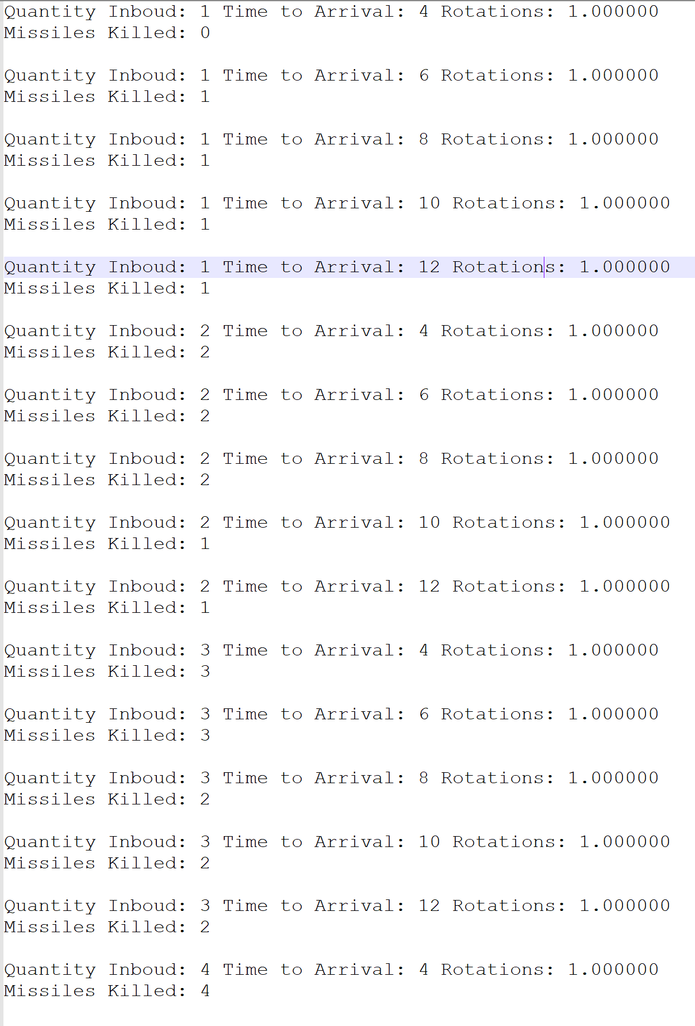
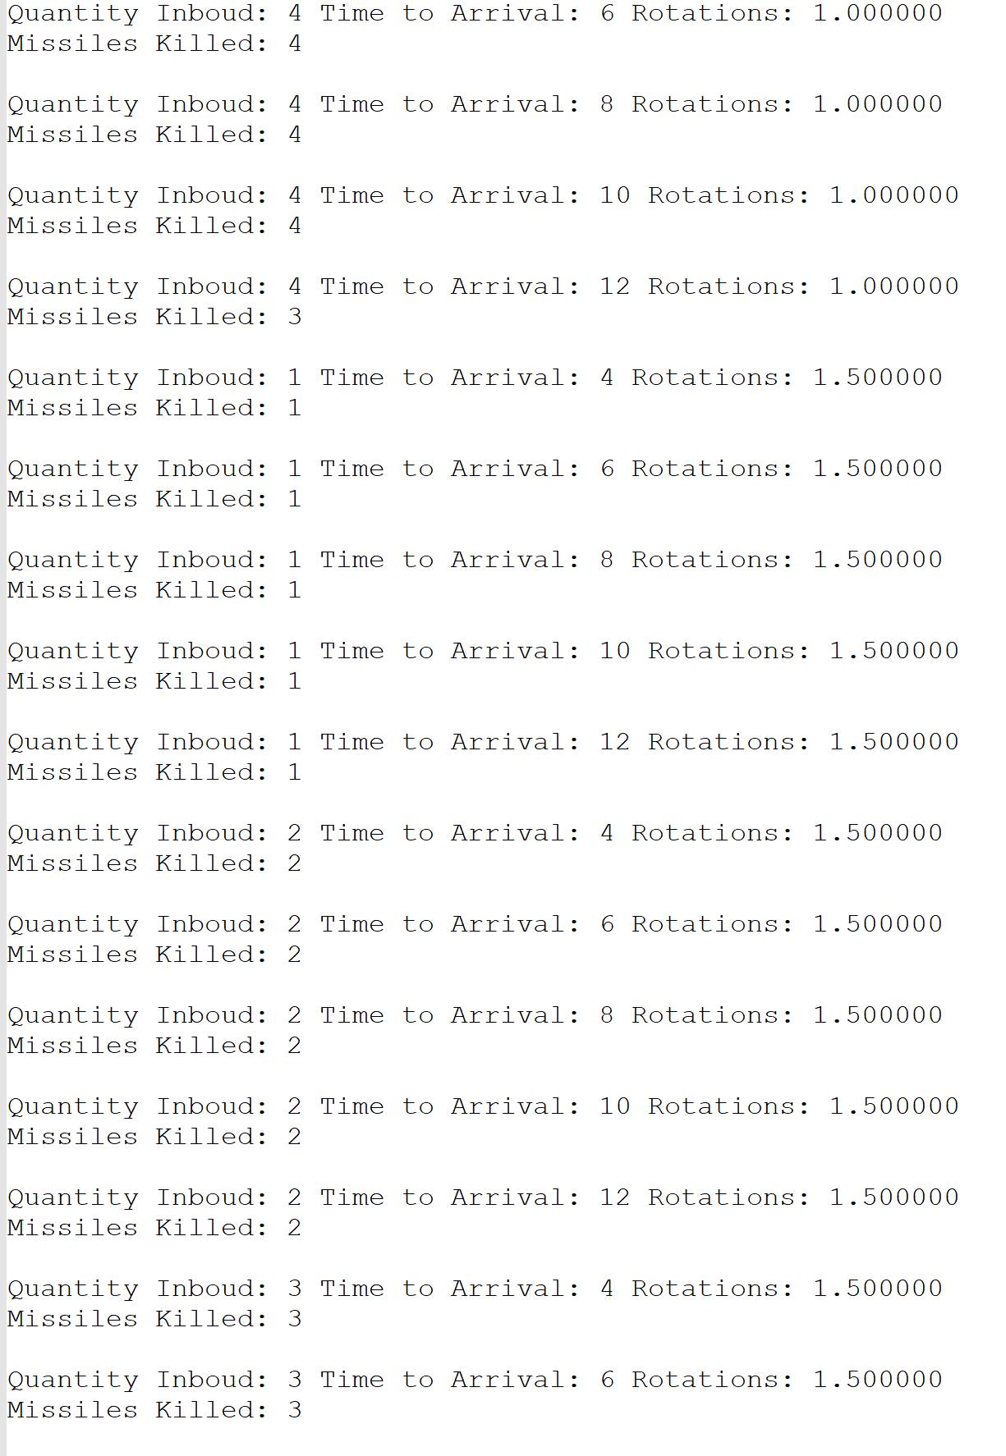
Raw Data From Tests

Slide 7
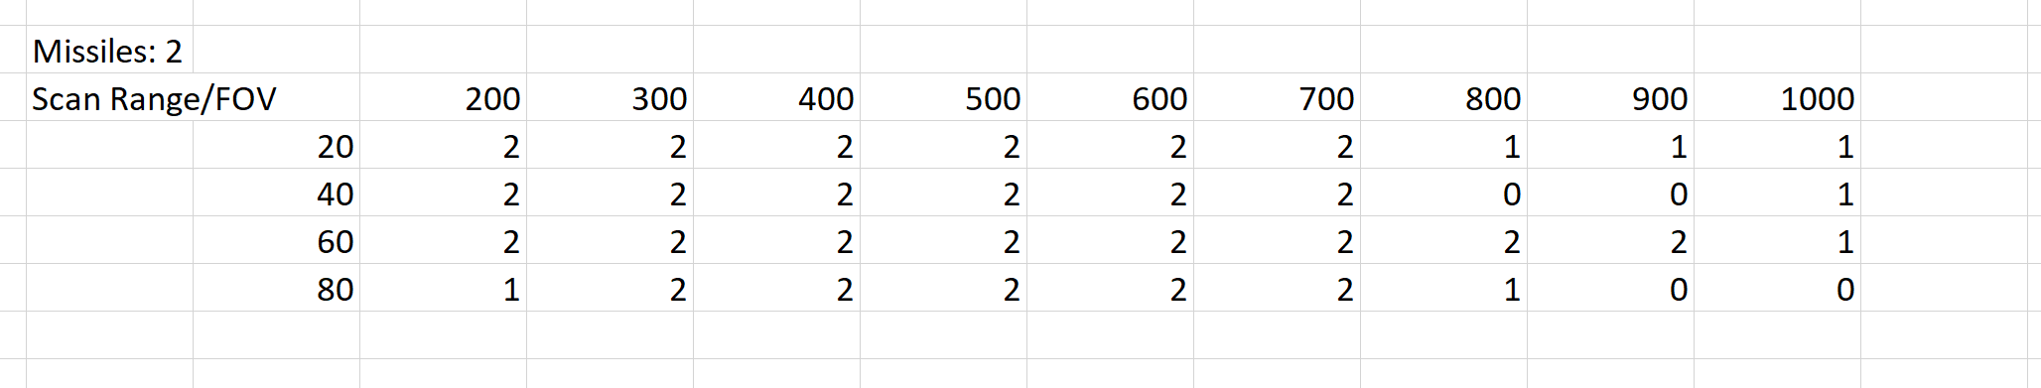
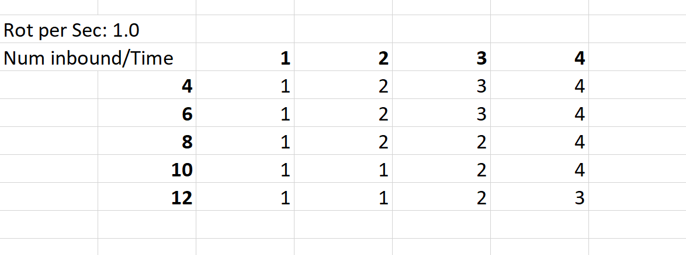
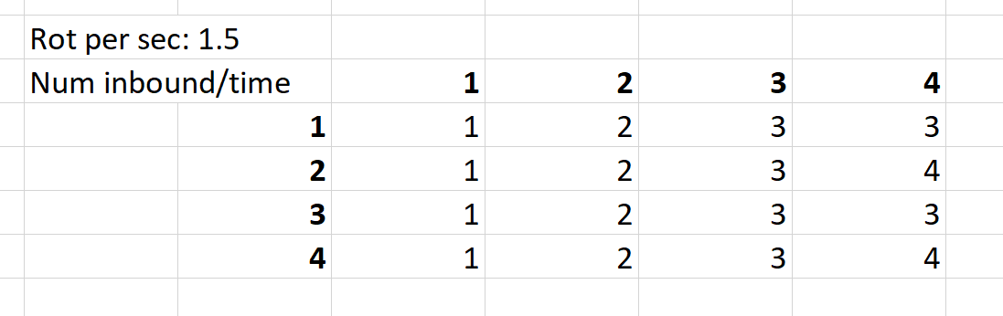





Some Data Charts

Slide 8
Weaknesses/Strengths in System
IN GERERAL: weaknesses most prevalent in parameters users set!
Slower rotations with more missiles = less accurate
Expected outcome
Increase scan range = less accurate
Increased time of arrival = less accurate
Unexpected outcome
Rotation speed of about 1.5 Rotations per Second was most optimal in general, only slight decreases in performance (might also be error)
Pros:
Even with some weaknesses, system still performed
Stable performance with high #inbound missiles
Stable performance with very fast inbound missiles
Will always detonate high above the ground

Slide 9
Team Hours and Morale
Lt Claire Badger(35 hrs)
Hrs Breakdown
Sensor changes, Automated Tests, Debug
Biggest Time sinks: Debug
Current Morale Status: Medium
Lt Brian Garland (50 hrs)
Hrs Breakdown
Setting up Red missiles, math, debug/cleaning code
Biggest Time sinks: Math/collision
Current Morale Status: Medium
Lt Mark Demore (40 hrs)
Hrs Breakdown
math, debug/cleaning code
15hrs on the phone with Brendan, usually late in the evening, candles lit
Biggest Time sinks: Math
Current Morale Status: Higher than the apex of a WOInterceptorMissile’s trajectory

Slide 10

Questions?

